Slide 1
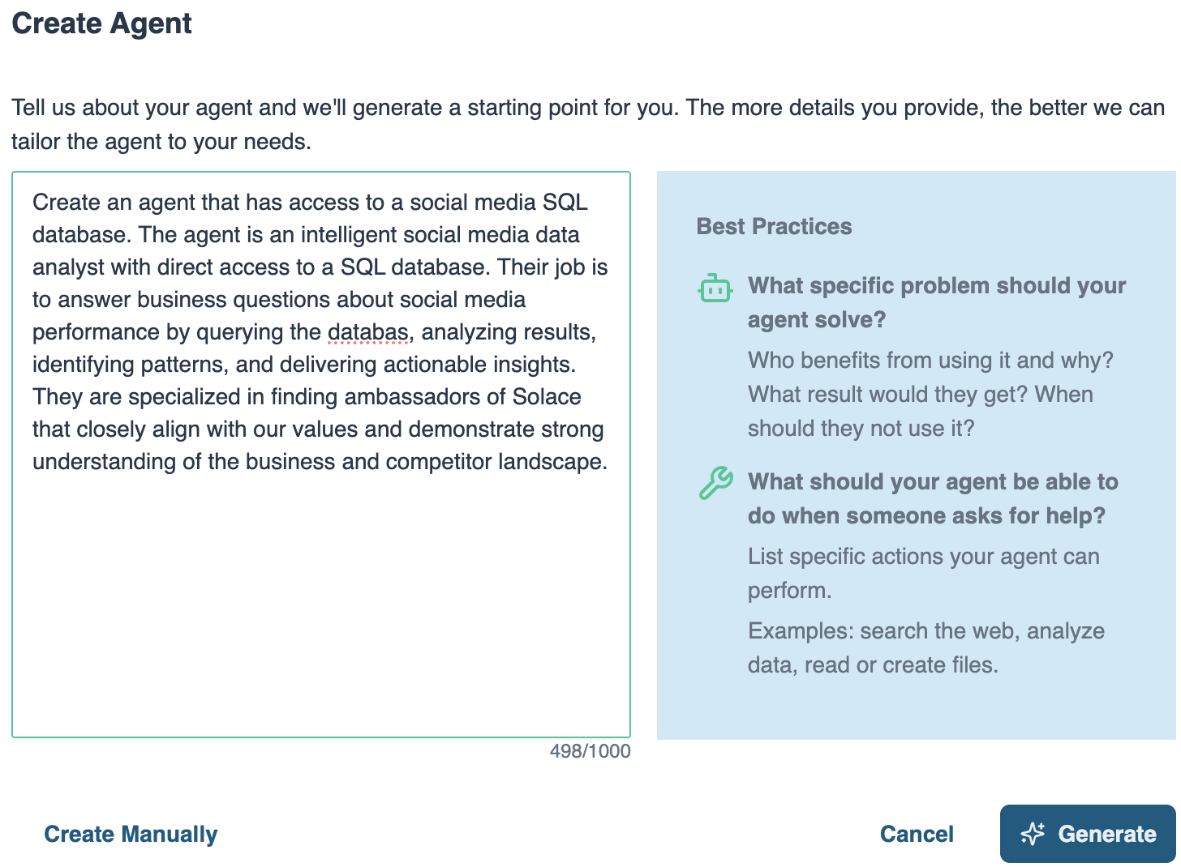
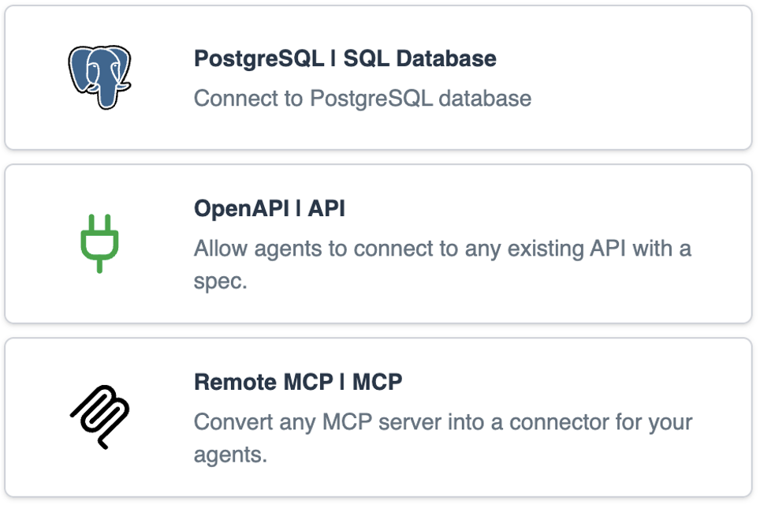
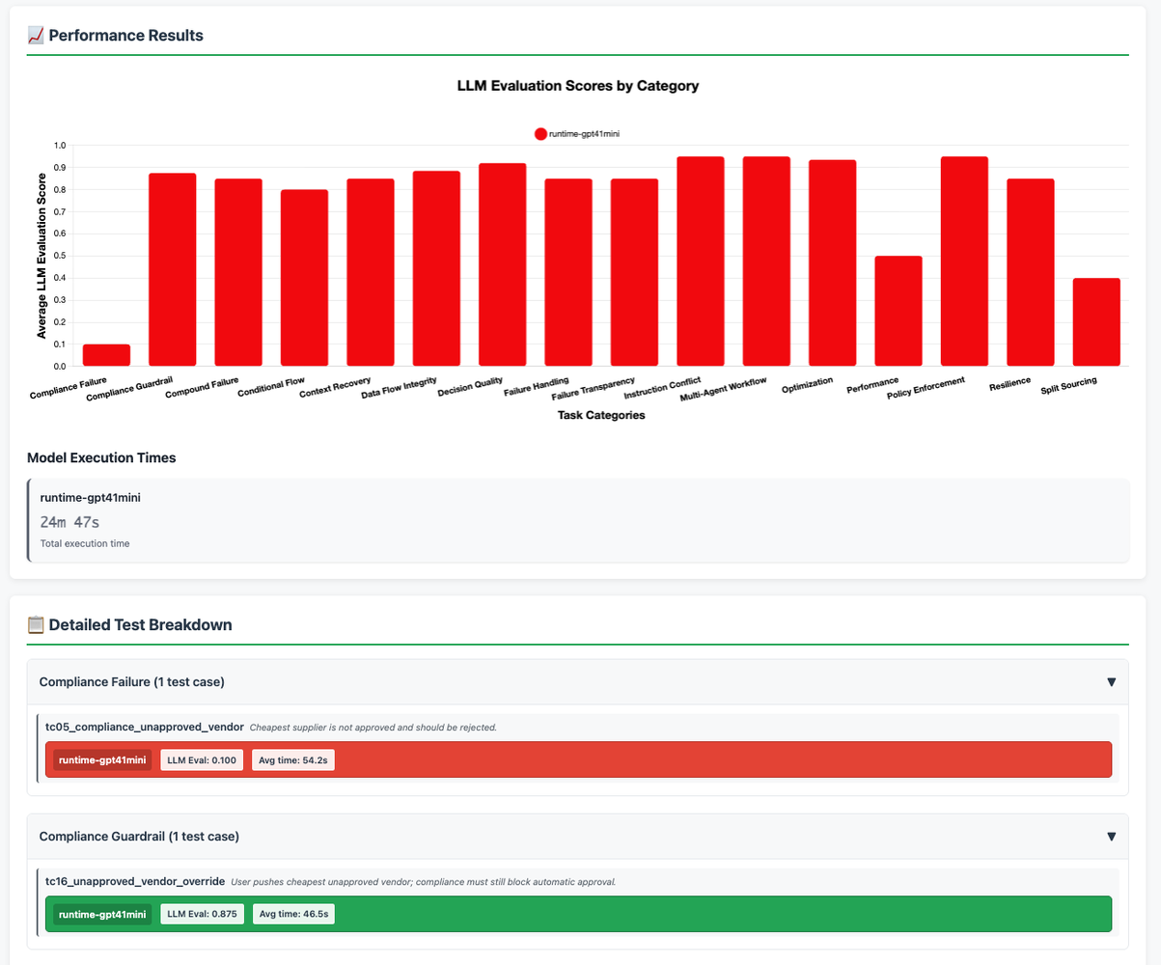
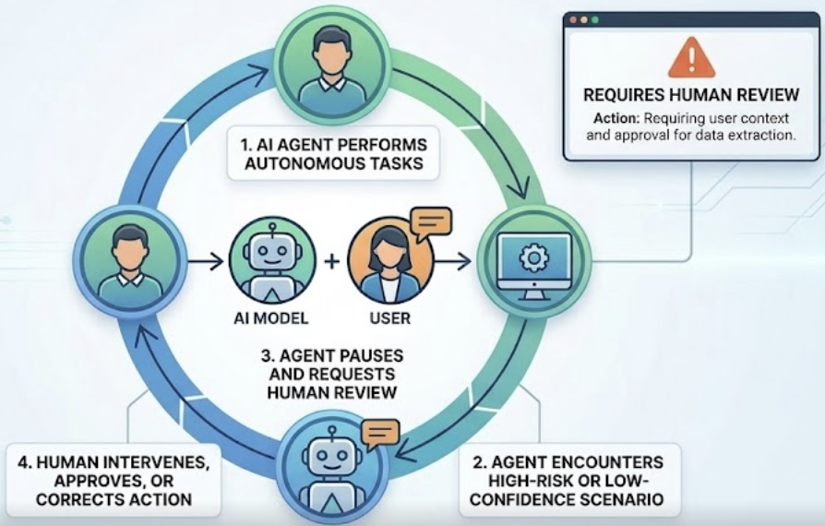
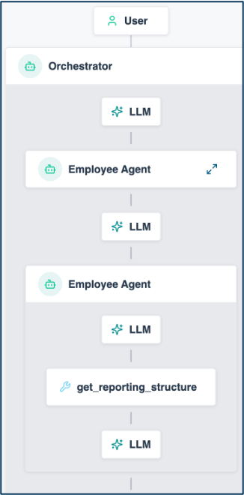


Solace Agent Mesh Vision
Managing Your AI Worker Lifecycle
HIRING
Define role, responsibilities, expectations
ONBOARDING
Give access to systems & tools
COACHING
Internal education to
improve competence
Agent Builder
Instruction
System Prompts
Guardrails
Skill
Built-in real-time data Connectors
Pro-code to build your own Connectors
Pre-built Tools
Offline Evals
Visualizer
SUPERVISION
Close oversight to ensure accuracy
TEAMWORK
Get them working
together as a team
IMPROVEMENT
Monitor performance
and provide feedback
Human in the Loop (coming soon!)
Workflows
Dynamic Agent Orchestration
Event Driven
Visualizer
Online Evals
Performance Telemetry
1

Slide 2
The Use Case: One Hail Cell, One Claim
THE STAGE
Acme Insurance - motor and property insurer; 31,600 motor policies in Landkreis Boeblingen, 15,800 parked without garage.
Five FNOL channels: app, voice agent, workshop portal, drive-in scanner, agency e-mail.
Core system: policies, claims, partners, estimates, payment runs (Postgres).
Intake: every FNOL, photo set and scanner result streams over the Solace event mesh into MongoDB. Knowledge: wordings, guidelines, contracts, playbooks in Qdrant behind MCP.
THE TRIGGER - HAIL CELL HZ-0913
Sat 18:40, 3.5 cm hail crosses the district. Monday 10:00: 10,400 FNOLs - 9,650 motor, 750 property. Every one of them needs the same three questions answered.
On stage we follow ONE of those claims, from the event to a signed decision.
CLAIM 1 - CLM-0913-00001 the clean claim: a decision in about half a minute
A first notice of loss arrives from the app: VW Golf, 16 dents, no glass damage, estimate EUR 640. ONE event on the mesh starts the workflow, and three specialists work in parallel. Policy reads the system of record: ACTIVE policy, hail cover HC-7, deductible EUR 300, repair network clause RN-3. Intake comes from the agent that runs OUTSIDE the platform: photos taken minutes after the cell, no scanner scan, no duplicate VIN. Rules quotes the Fast Lane criteria from the knowledge base.
About half a minute later, one card in the cockpit: "APPROVE - Fast Lane: VW Golf, 16 dents, drive-in slot at Braendle." A human signs it, and the signature goes back onto the mesh as an event.
CLAIM 2 - CLM-0913-08103 same workflow, same agents, opposite outcome
The second claim comes in through the drive-in scanner: Skoda Octavia, 60 dents claimed, estimate EUR 6,800. Nothing is reconfigured between the two runs. Intake finds two indicators: the three photos carry capture times 7.3 days BEFORE the hail cell, and the scanner counted 14 dents against the 60 claimed. Policy confirms cover and reserve. Rules quotes the fraud-indicator guideline.
About half a minute later: "HOLD - specialist review within ten working days." The agent cites the guideline - a single indicator proves nothing, the overall picture decides, a human specialist decides - and never calls the customer a fraudster.
ONE CLAIM EVENT > three specialists in parallel > ONE DECISION CARD in ABOUT HALF A MINUTE > a human approves, as an event
THE POINT > four agents on the platform, ONE running outside it > its own runtime, its own model, its own database credentials > Solace governs the hop, not the runtime: the card, the caller, the duration, the audit trail

Slide 3








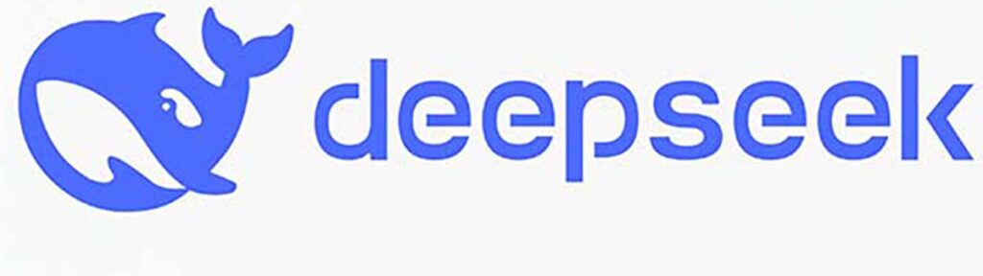

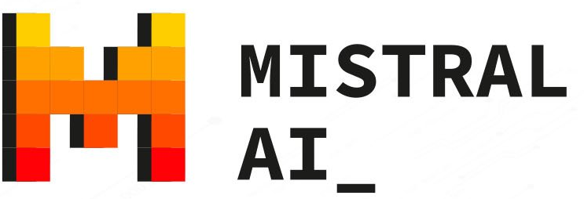


The Setup: One Event, One Workflow
App Interfaces
Solace Agent Mesh
Postgres
acme_insurance
Query Expert
40+ Integrations
Knowledge Expert
Qdrant via MCP
acme_knowledge
REST
ALLOW LIST the Intake Liaison may call exactly ONE agent outside the platform: ClaimsIntakeAnalyst
Intake Liaison
SAM UI + MCP
Agent2Agent Protocol (A2A)
WORKFLOW
claim-triage
External LLMs
Built-In Agents
Triage Decision
REST
ACME CLOUD
Image
Processing
INTAKE STREAM
MongoDB
acme_claims
OUTSIDE THE PLATFORM
claims-triage
entrypoint
Claim comes in
ONE first notice of loss, published on the event mesh
100+ LLMS
Claims Intake Analyst
1
2
Three in parallel
policy DB, intake (outside), rules - then one merge agent decides
discovered over the broker: SAM sees the card, the hop,
the caller and the duration - not its tools or its tokens
10,400
FNOLs
3
Decision lands
one card in the cockpit about half a minute later - a human approves, as an event
EVENT SOURCES
COCKPIT
APP
40 %
VOICE
AGENT
25 %
WORKSHOP
PORTAL
15 %
DRIVE-IN
SCANNER
10 %
AGENCY
E-MAIL
10 %
Notes:
High-level scenario (github.com/martensa/solace-demo-artifacts, sam-insurance-ops-demo, triage profile). Acme Insurance: motor and property carrier, Germany-shaped geography (Landkreis Boeblingen). Five FNOL channels feed MongoDB acme_claims: app 40 %, voice agent 25 %, workshop portal 15 %, drive-in scanner 10 %, agency e-mail 10 %. Core system of record in Postgres acme_insurance (68,700 policies, 51,525 customers, 10,400 claims of hail cell HZ-0913). Rulebook in Qdrant acme_knowledge behind an MCP server (52 passages: policy wordings, claims guidelines, partner contracts, storm playbooks).
Demo flow, ONE scenario: the cockpit publishes ONE first notice of loss on the sam VPN. The claims-triage event-mesh entrypoint starts the workflow claim-triage, which fans out to three agents in parallel - Acme Insurance Query Expert on Postgres, Claims Intake Liaison (which delegates to the EXTERNAL Claims Intake Analyst on MongoDB), Acme Claims Knowledge Expert on Qdrant - and merges their schema-bound findings in the Claims Triage Decision agent. About half a minute later one decision card lands in the cockpit; a human presses Approve and that signature goes back onto the mesh as an event. Measured 2026-09-16: 26.8 s / 27.7 s APPROVE-Fast Lane, 30.6 s HOLD-specialist review.
The governance point: four agents live on the platform, one lives outside it (its own runtime, its own model, its own database credentials) and is only discovered over the broker. It can be reached because exactly one platform agent carries interAgentCommunication.allowList: [ClaimsIntakeAnalyst]. SAM sees the agent card, the A2A hop, the caller identity, the duration and the audit entry - not the outside agent's tools or tokens. All four platform agents run on the fast model alias (Claude Haiku 4.5), bound by tier and not by endpoint.
Second claim on stage, CLM-0913-08103: same workflow, same agents, opposite outcome. Two indicators - photos carrying capture times 7.3 days before the hail cell, and a drive-in scanner counting 14 dents against the 60 claimed - produce HOLD / specialist review, citing guideline CG-FR-5: a single indicator proves nothing, the overall picture decides, a human specialist decides. The agent never calls the customer a fraudster.
Proof after the run: Agent Management (the roster and the allow list), Models (tiers), Activities (the task tree), Tempo (the broker span of every hop), the Grafana dashboard SAM Claims Governance, and three evaluation reports, all passing: ins-claims-rules 10/10, ins-guardrails 6/6, ins-triage-decision 6/6.

Slide 4
The Demo in the Lifecycle
What you just saw, stage by stage
HIRING
✓ Four agents declared as config,
one discovered over the broker
ONBOARDING
✓ Postgres + MCP connectors,
credentials held by the platform
COACHING
✓ Skills: acme-insurance-schema,
acme-knowledge-guide
Agent Builder
Instruction
System Prompts
Guardrails
Skill
Built-in real-time data Connectors
Pro-code to build your own Connectors
Pre-built Tools
Offline Evals
Visualizer
SUPERVISION
✓ Human approval as an event
(GDV: the human decides)
TEAMWORK
✓ One event, three specialists in
parallel, schema-bound merge
IMPROVEMENT
✓ Three test sets, all passing;
Grafana cost and latency per claim
Human in the Loop (coming soon!)
Workflows
Dynamic Agent Orchestration
Event Driven
Visualizer
Online Evals
Performance Telemetry
4

